Slide 1
Smartphone sensors

Slide 2
Content
01.Data Visualization
02.Make comments
Through using given information and files, all smartphone sensor data is visualized.
Time is accepted as a free variable for all sensor data.
Making explanations about the given three questions

Slide 3
Data visualization

Slide 4
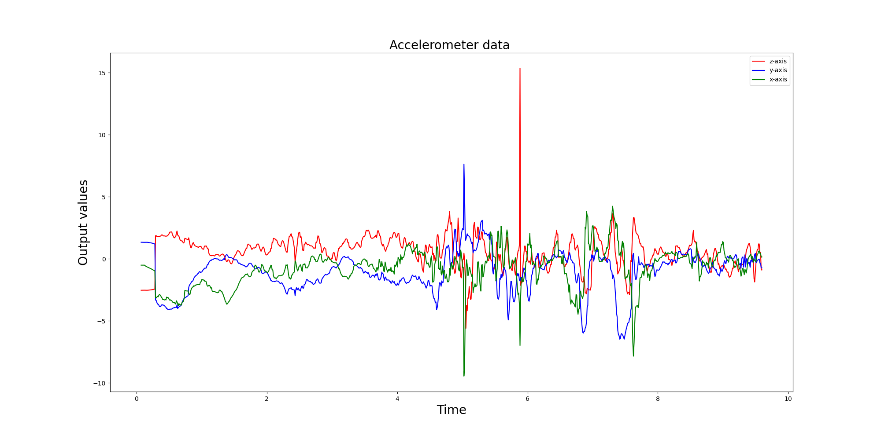

Slide 5
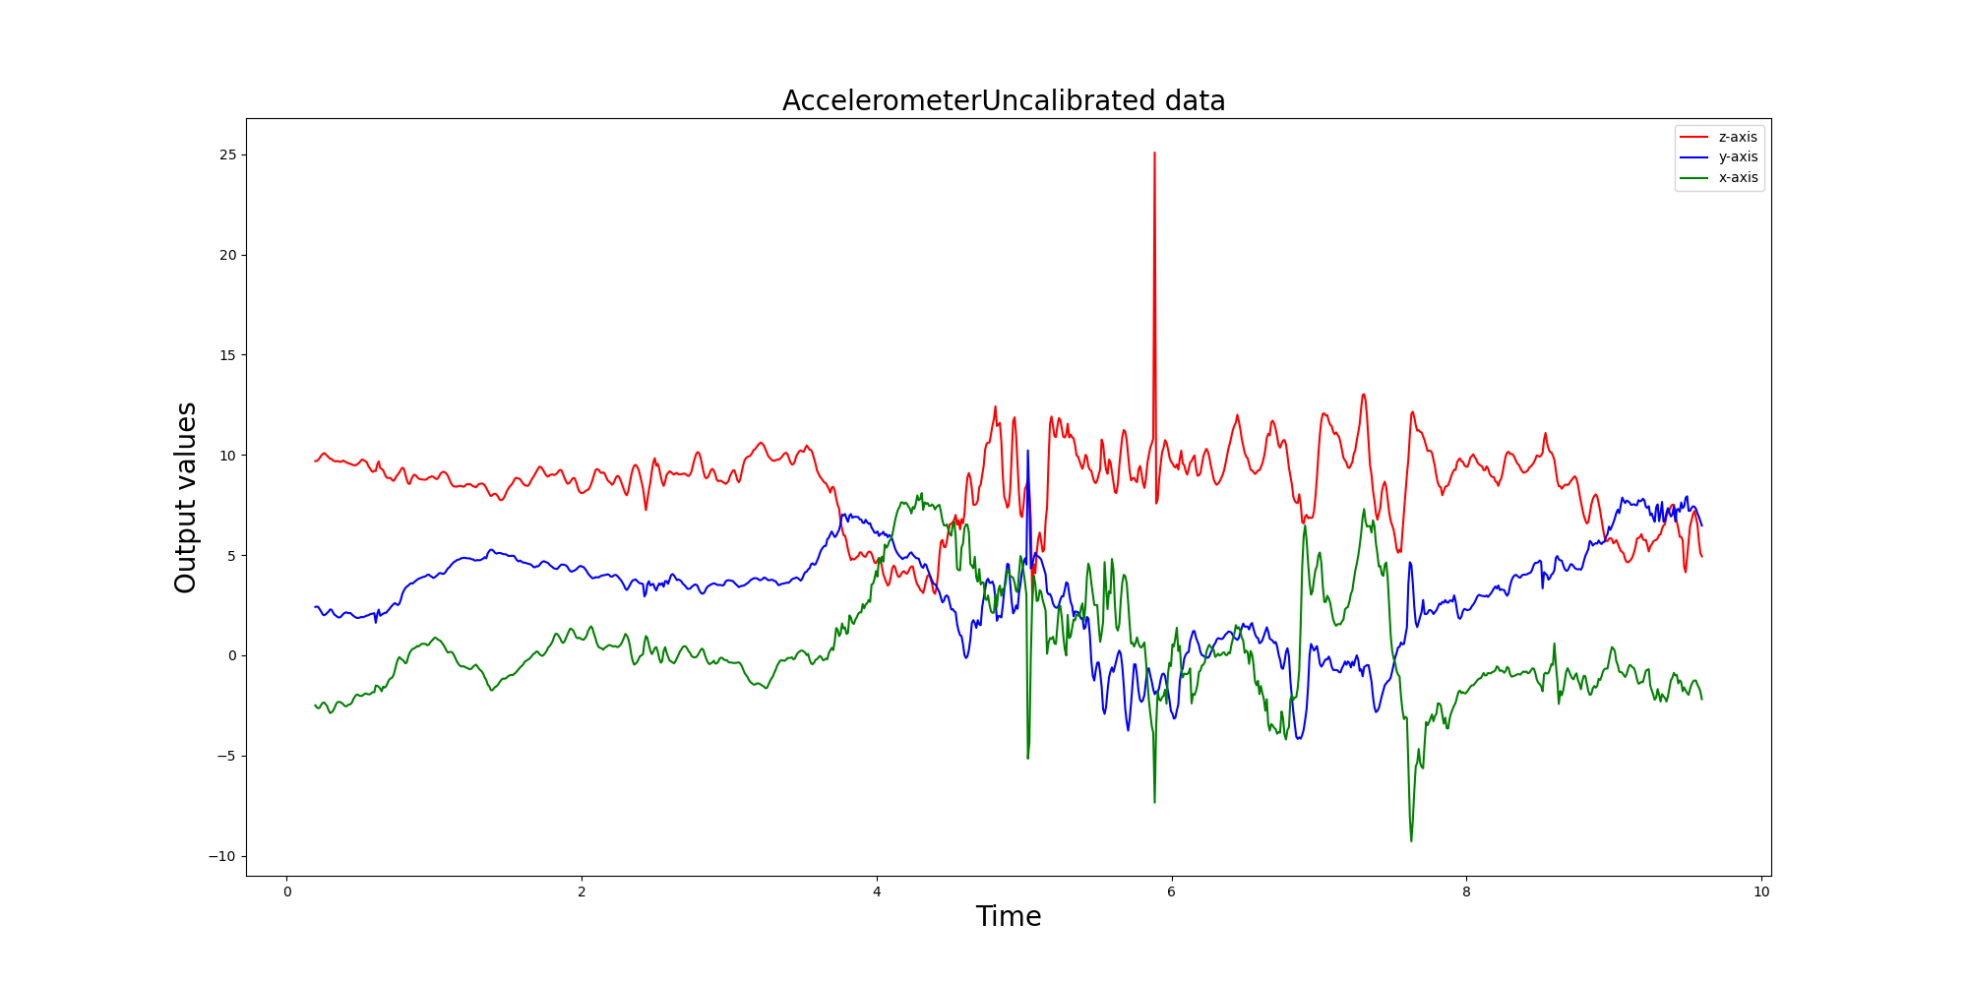

Slide 6
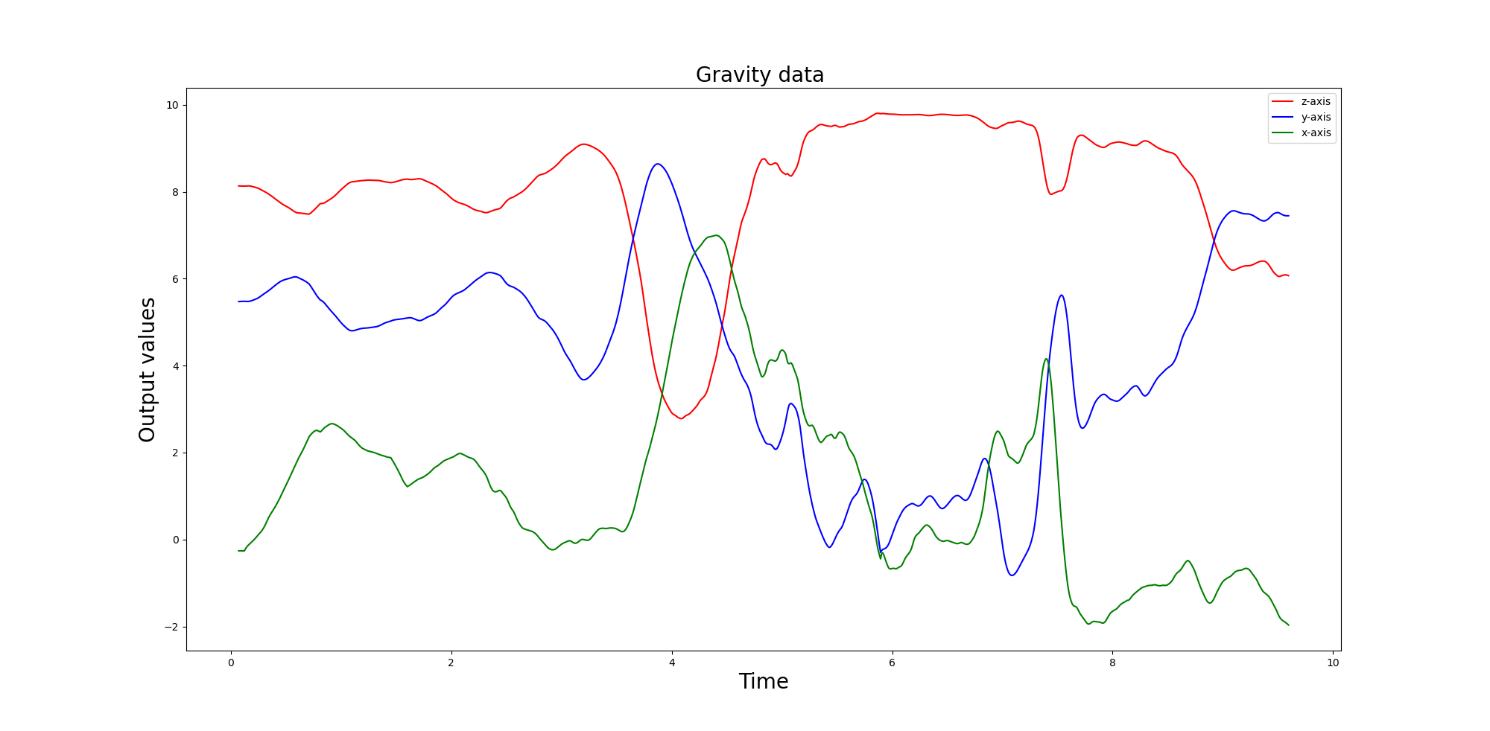

Slide 7
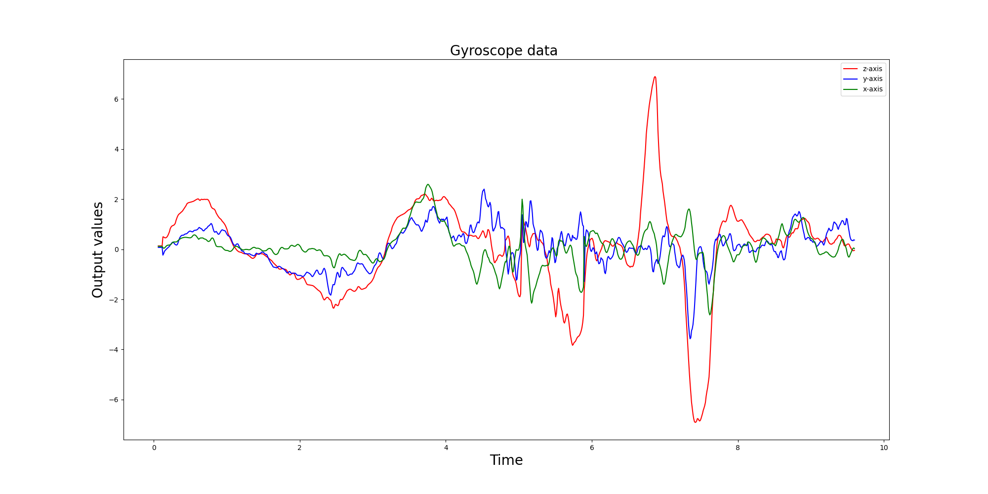

Slide 8
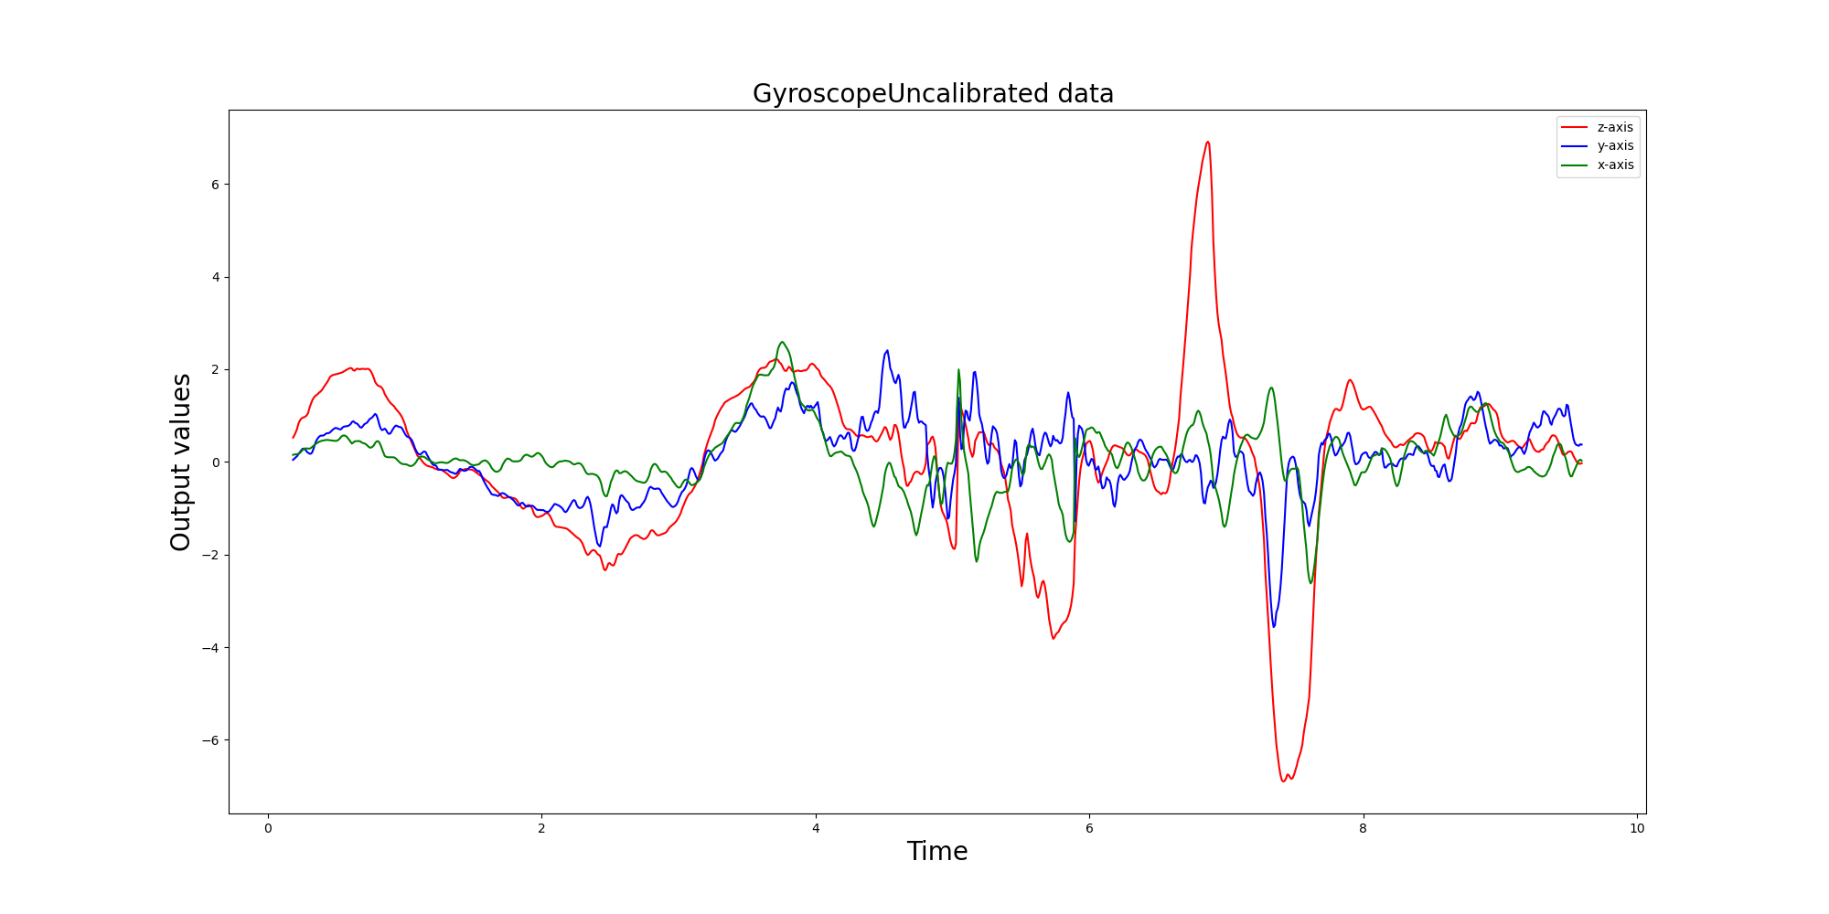

Slide 9
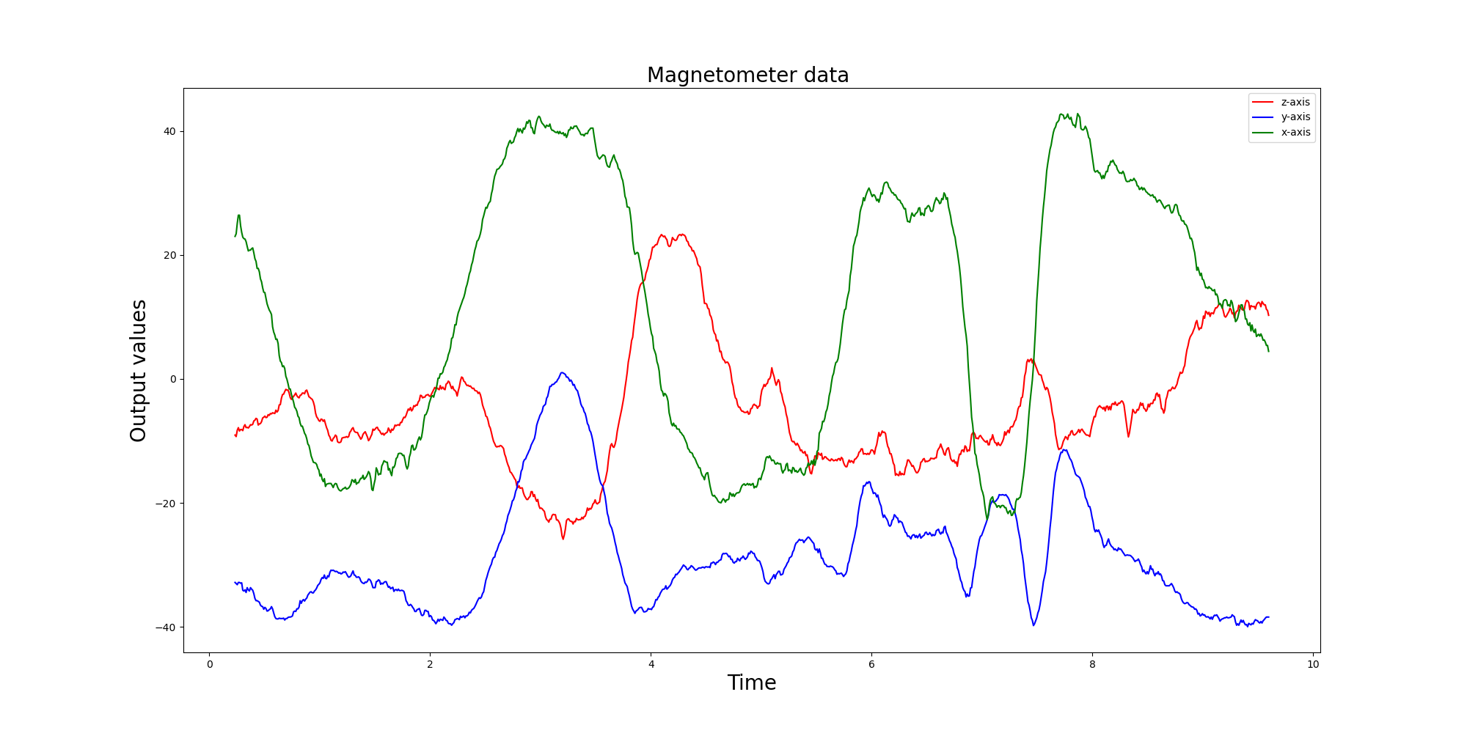

Slide 10
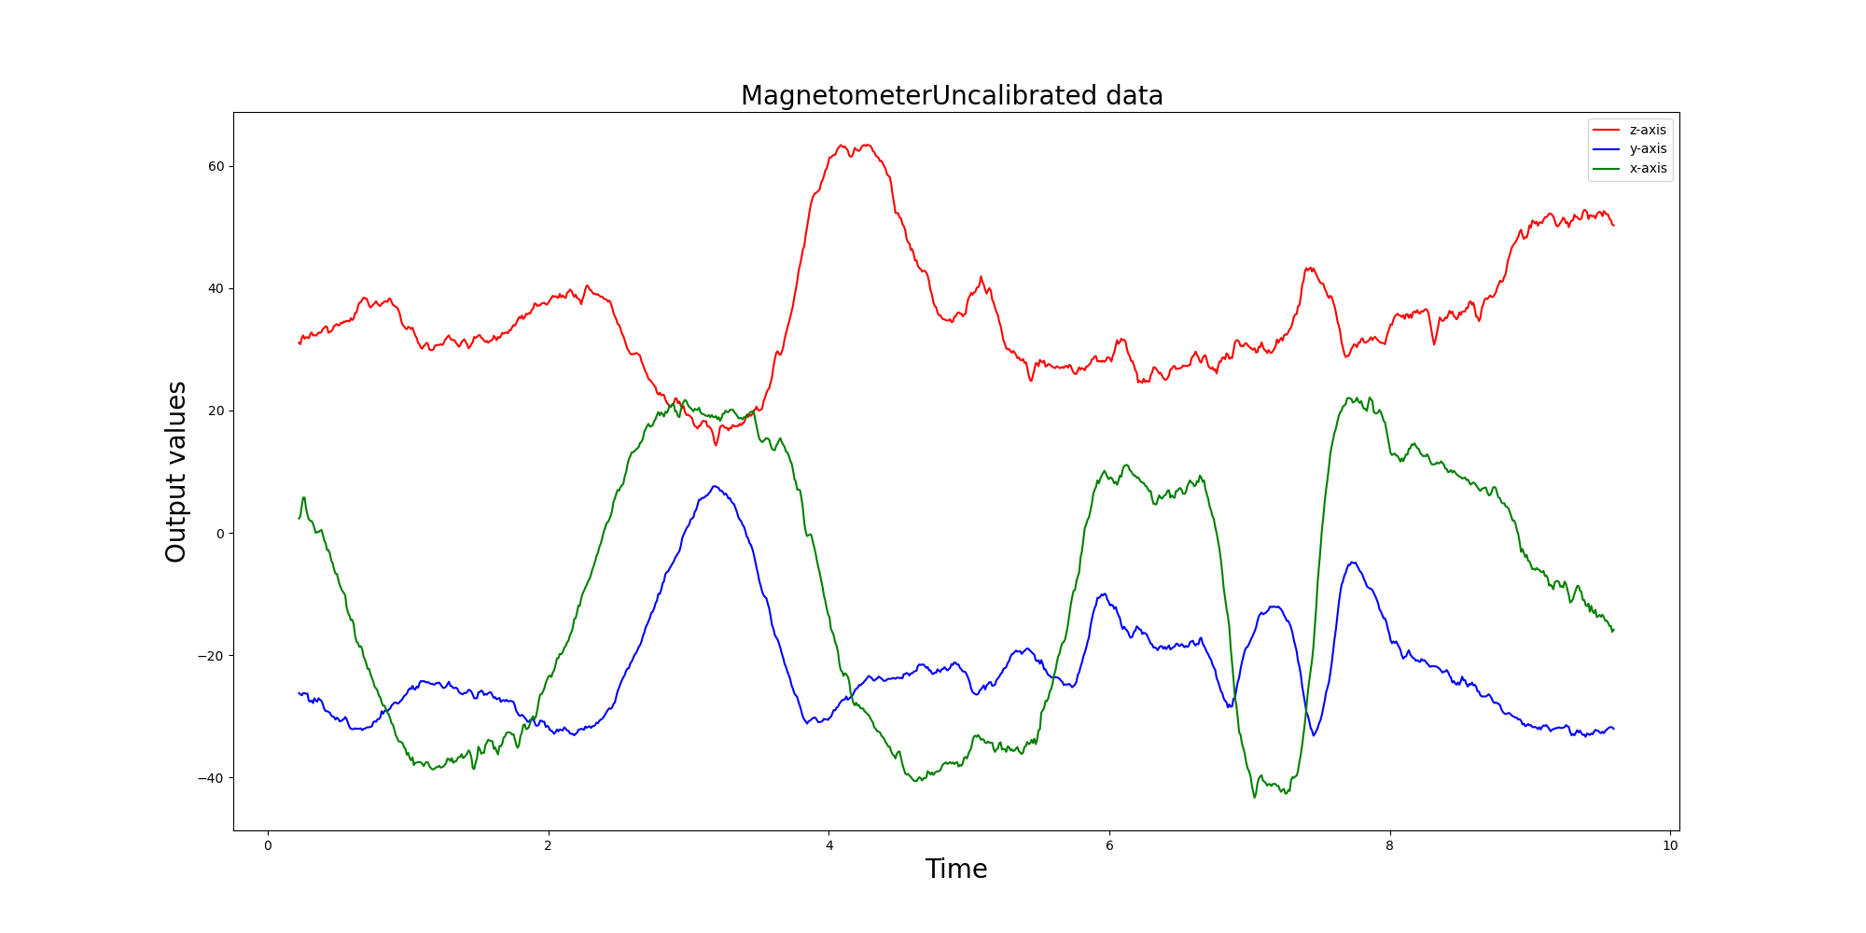

Slide 11
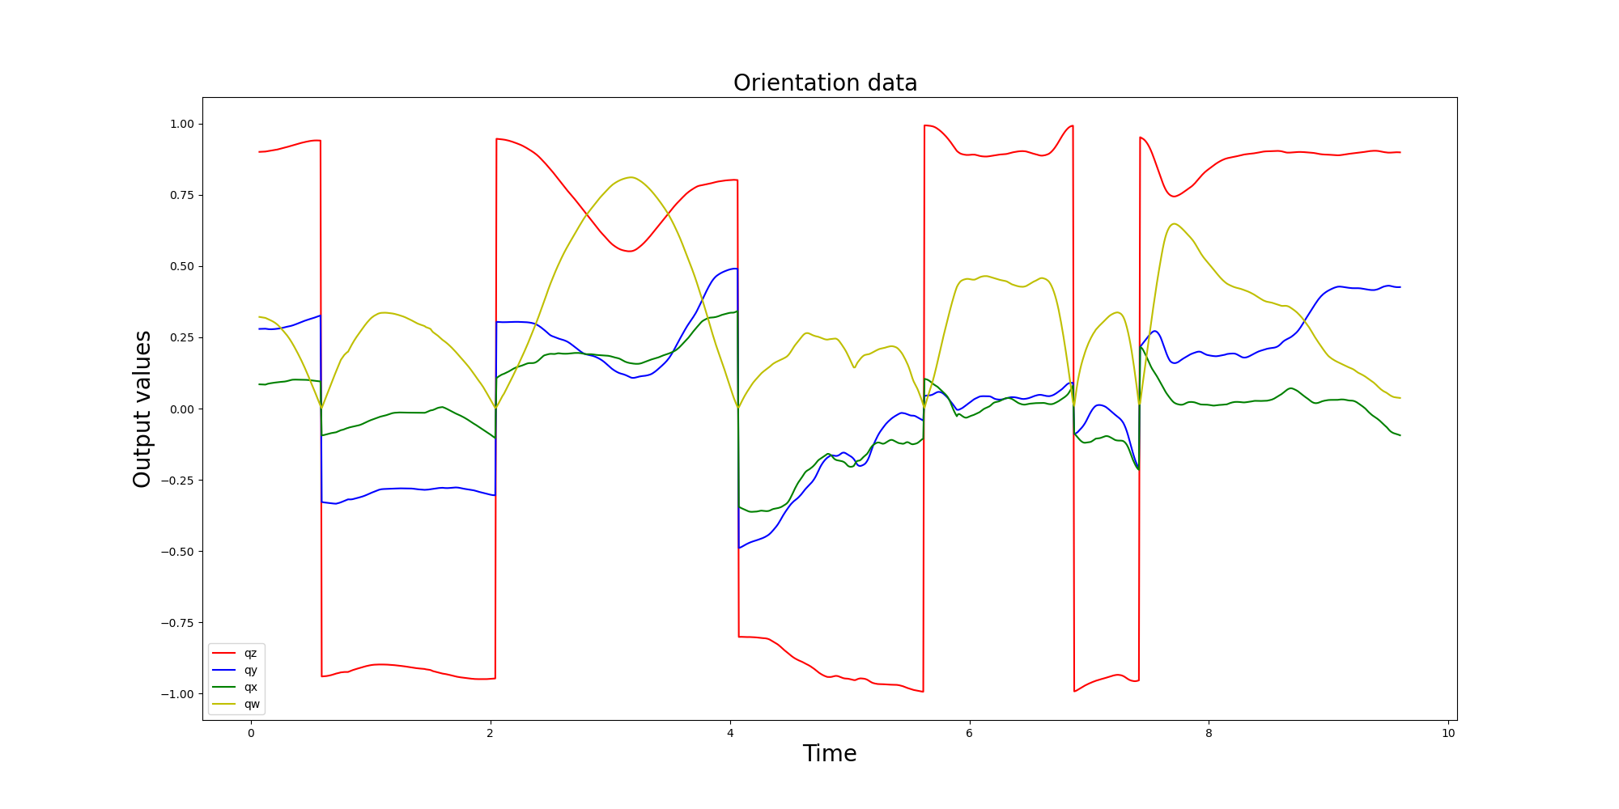

Slide 12
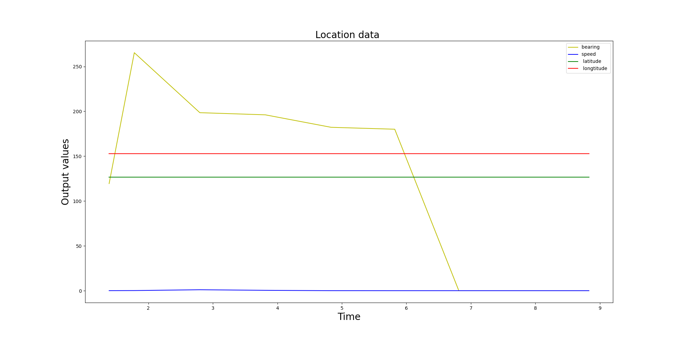

Slide 13
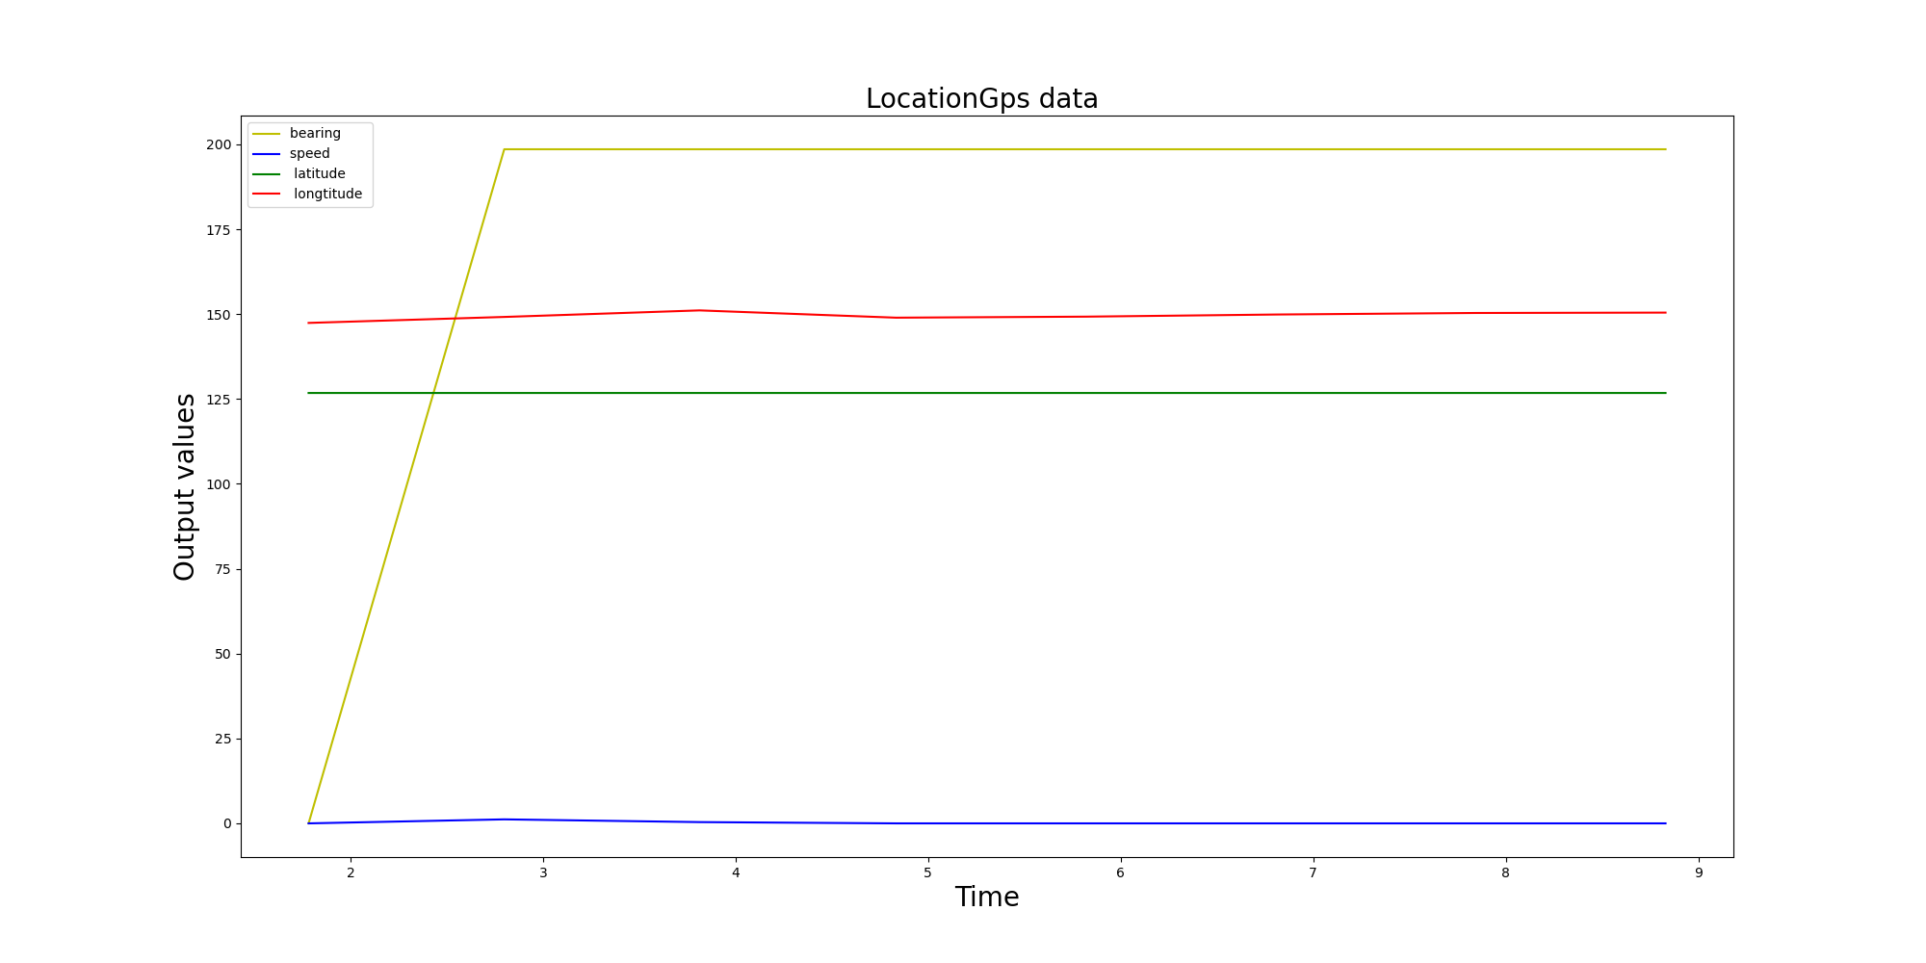

Slide 14
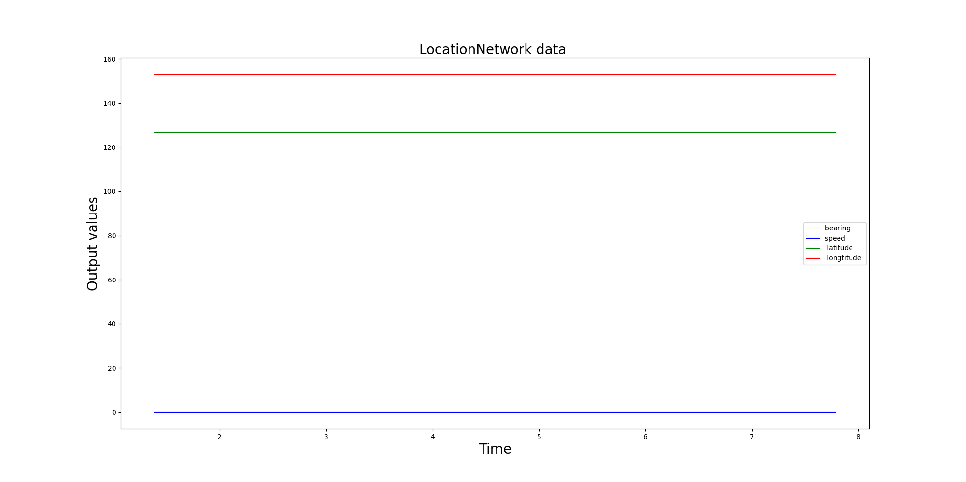

Slide 15
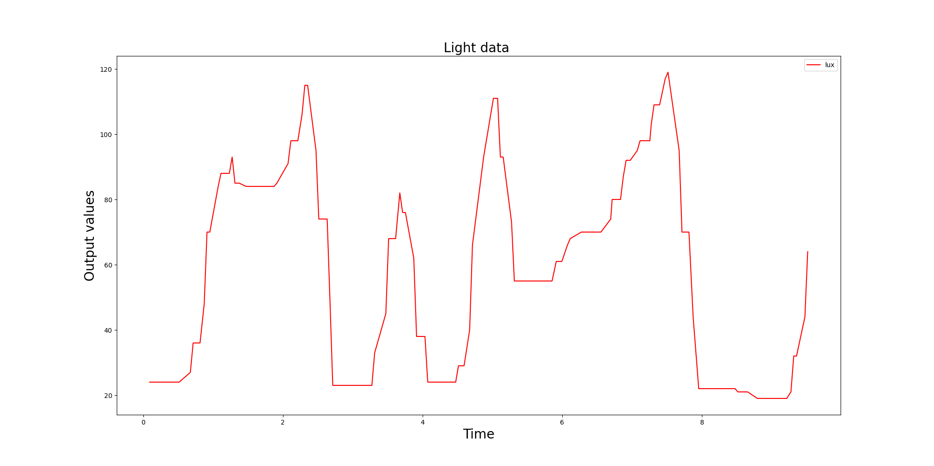

Slide 16


